Slide 1
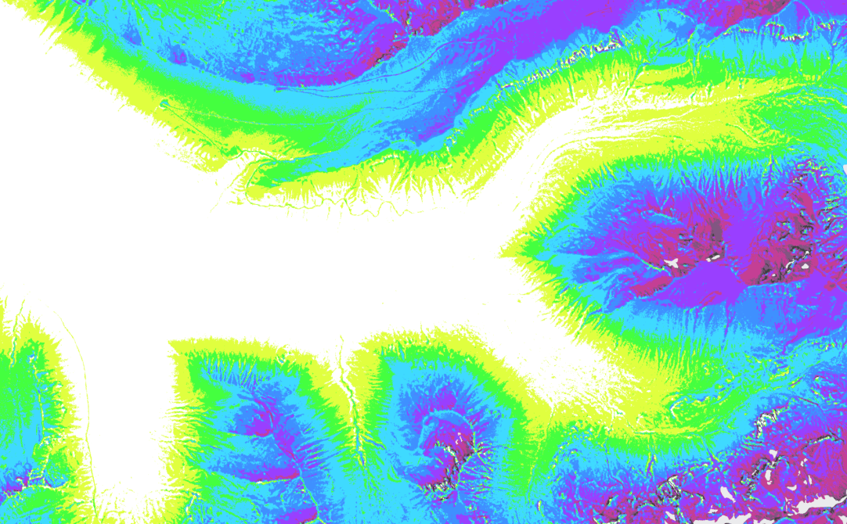
RMBL Spatial Data Science Webinar Series
Webinar 4: Leveraging Point-cloud Data from LiDAR and UAV Photogrammetry
Ian Breckheimer, PhD
RMBL Staff Research Scientist
@ibreckhe | ikb@rmbl.org

Slide 2
Webinar Schedule
RMBL Spatial Data Science Webinar Series

Slide 3
Outline
Why?
What?
How?
Why is this a good time to get comfortable with point cloud data?
What are the basic properties of point clouds, and how are they derived?
What are the strengths and weaknesses of SfM and LiDAR-derived point clouds
What are the core point cloud workflows?
Case Study: leveraging LiDAR point clouds to monitor forest mortality.
Demo: processing point clouds in CloudCompare and R

Slide 4
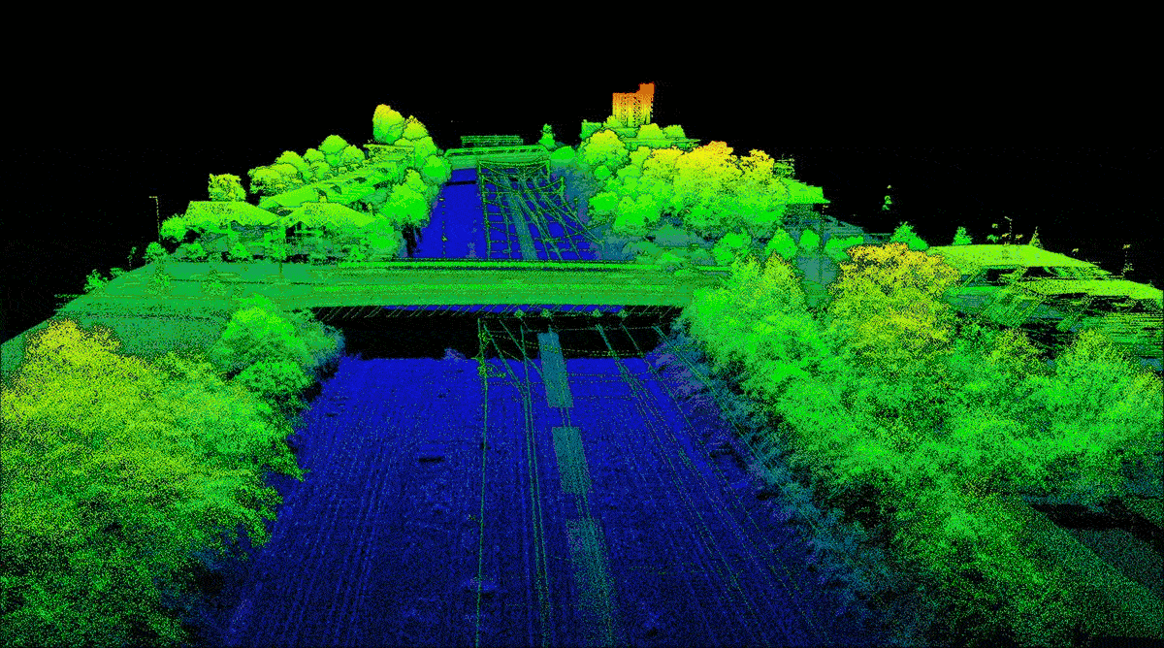
What are point clouds?
Z
Y
X
Image: Blom International

Slide 5
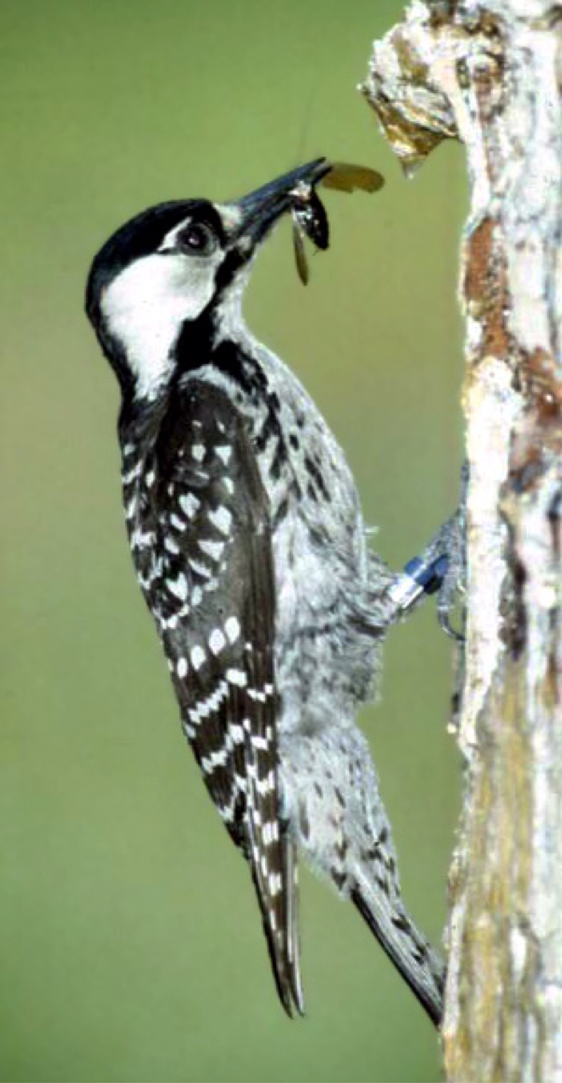
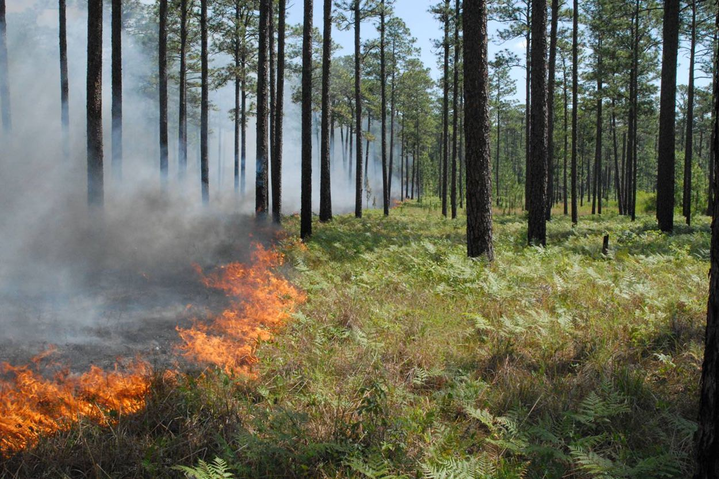
Why Point Clouds? 3D Structure matters.
Images: James Hanula, USFS

Slide 6
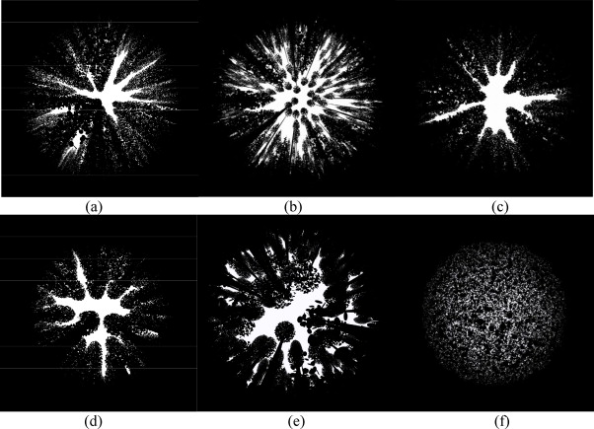
Why Point Clouds? 3D Structure matters.
Images: Leblanc and Fournier 2014

Slide 7
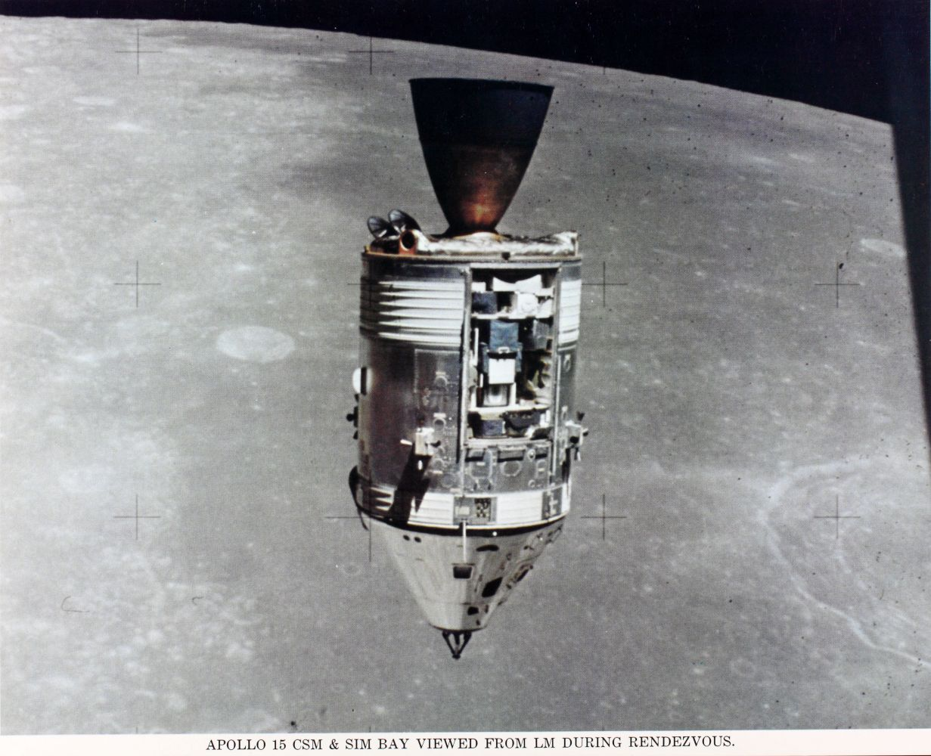
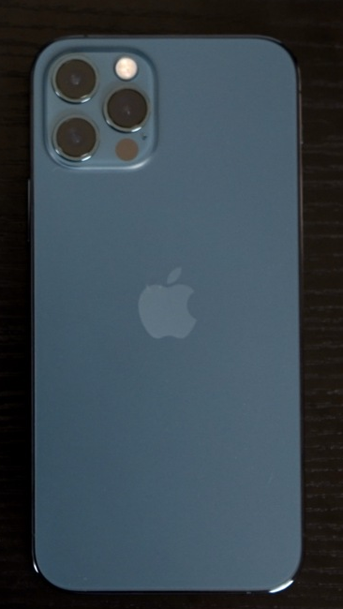
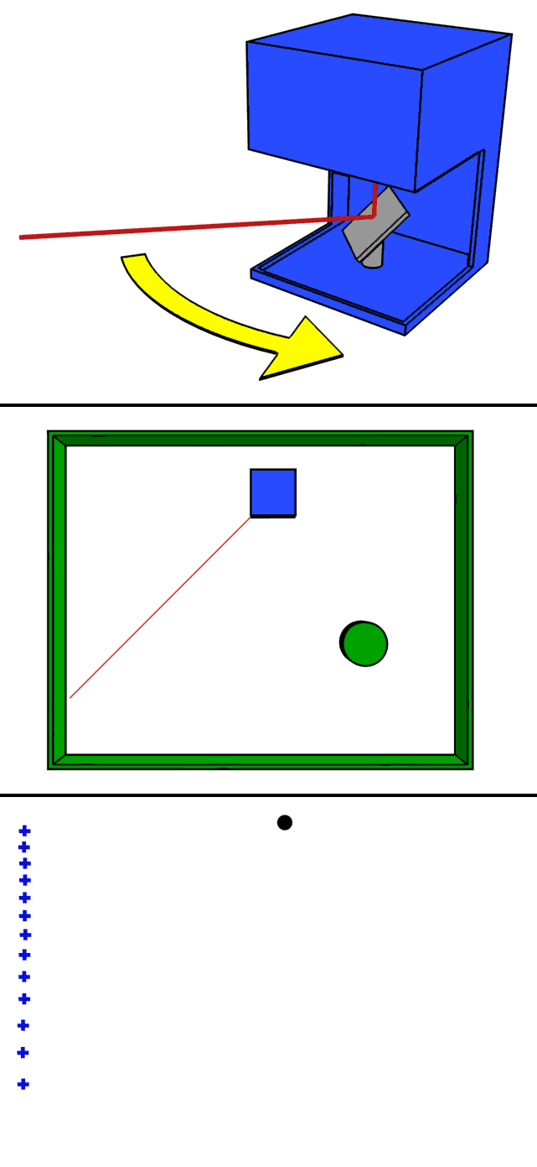
Why Point Clouds? New platforms and sensors.
LiDAR Then
LiDAR Now
Images: NASA, mike1024, Apple

Slide 8
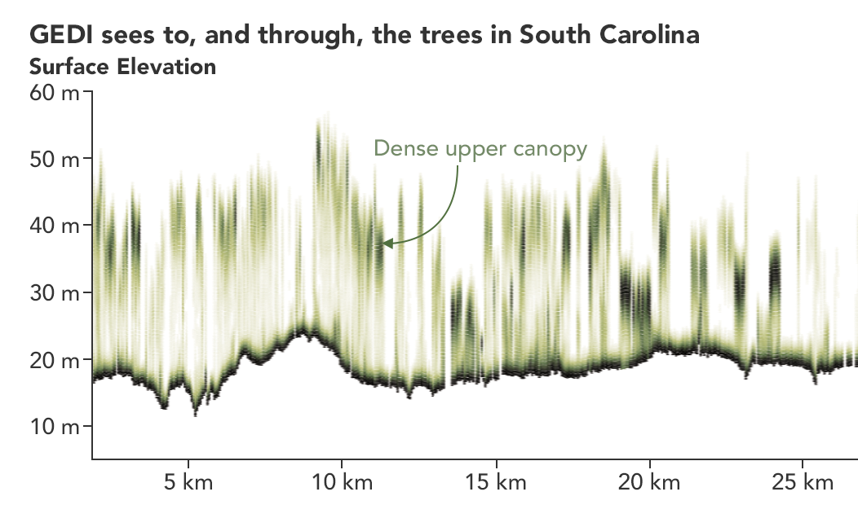

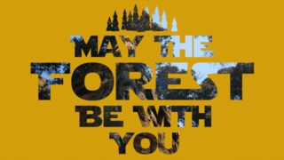

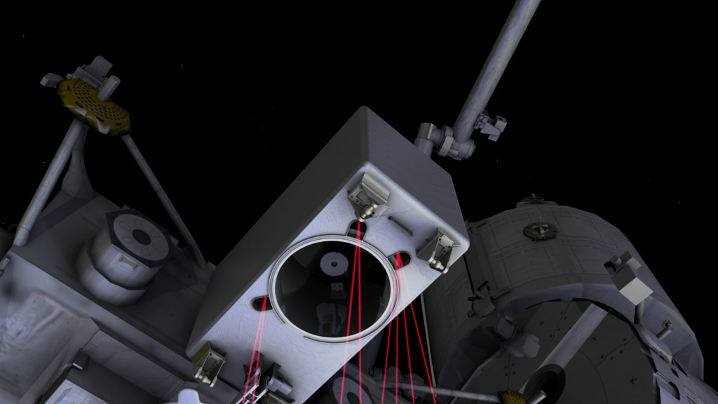
Why Point Clouds? New platforms and sensors.
Images: NASA, University of Maryland

Slide 9
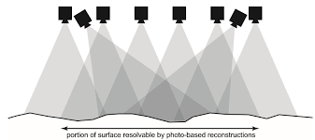
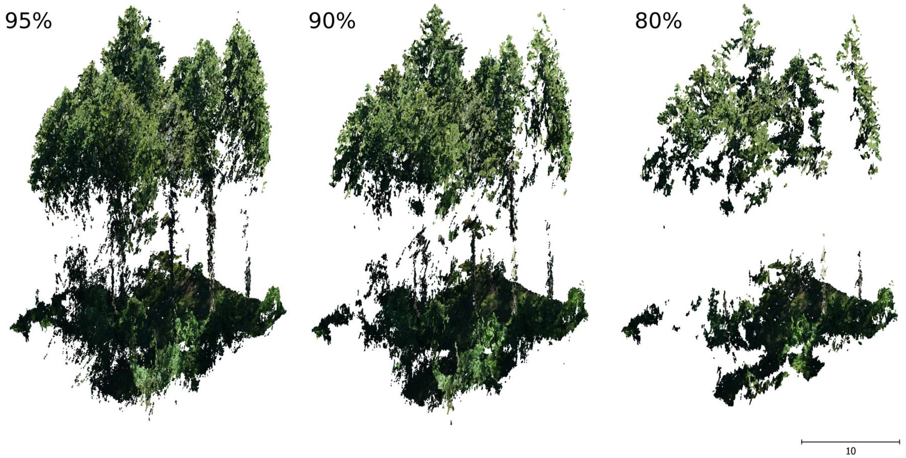
Where we are going, we don’t need lasers.
Images: SDFC

Slide 10
Outline
Why?
What?
How?
Why is this a good time to get comfortable with point cloud data?
What are the basic properties of point clouds, and how are they derived?
What are the strengths and weaknesses of SfM and LiDAR-derived point clouds
What are the core point cloud workflows?
Case Study: leveraging LiDAR point clouds to monitor forest mortality.
Demo: processing point clouds in CloudCompare and R

Slide 11
The structure of a point cloud dataset.
Coordinates
+ Attributes
Standard format: .las or .laz (compressed)
Challenges:
Always BIG
Sometimes messy

Slide 12
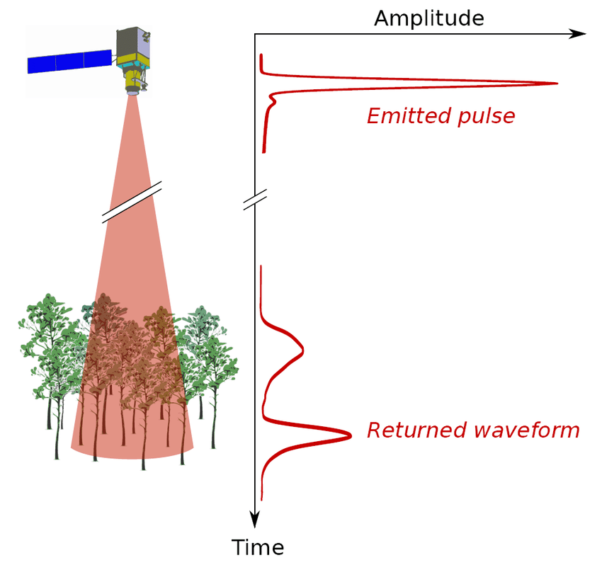
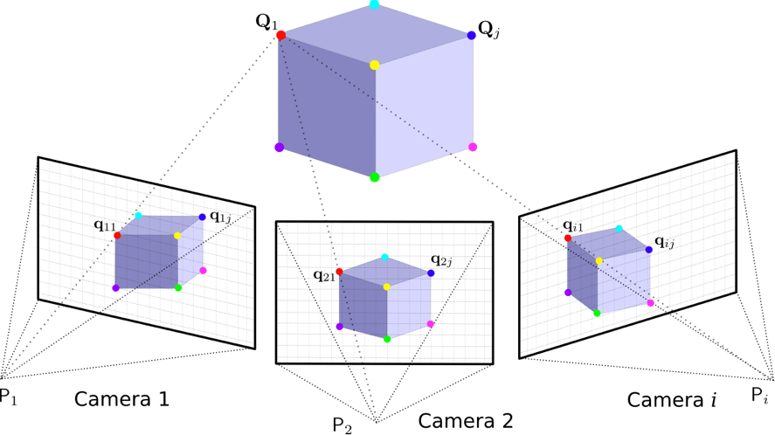
How do we get here?
LiDAR
Photogrammetry
Tie Points
1st Return
Last Return
Images: J. Fernandez-Diaz Hypraptive

Slide 13
Outline
Why?
What?
How?
Why is this a good time to get comfortable with point cloud data?
What are the basic properties of point clouds, and how are they derived?
What are the strengths and weaknesses of SfM and LiDAR-derived point clouds
What are the core point cloud workflows?
Case Study: leveraging LiDAR point clouds to monitor forest mortality.
Demo: processing point clouds in CloudCompare and R

Slide 14
LiDAR versus Photogrammetry Point Clouds
LiDAR (Airborne)
Photogrammetry
Pros:
Relatively uniform sampling
Constant, high spatial precision
Can penetrate vegetation
Rich spatial attributes (return number)
Cons:
Equipment still expensive
Limited spectral information
Lower point density
Pros:
(Usually) higher point density
Rich spectral information
Inexpensive equipment
Flexible deployment
Cons:
Variable precision and density
Expensive processing
Doesn’t “penetrate” dense veg

Slide 15
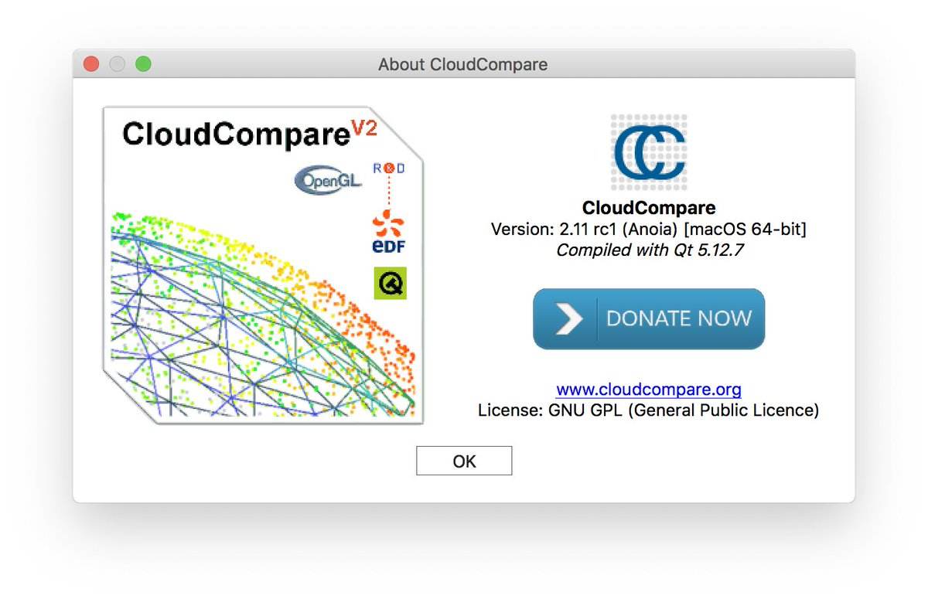
Demo: LiDAR versus Photogrammetry

Slide 16
Outline
Why?
What?
How?
Why is this a good time to get comfortable with point cloud data?
What are the basic properties of point clouds, and how are they derived?
What are the strengths and weaknesses of SfM and LiDAR-derived point clouds
What are the core point cloud workflows?
Case Study: leveraging LiDAR point clouds to monitor forest mortality.
Demo: processing point clouds in CloudCompare and R

Slide 17
Core Point Cloud Tasks for Environmental Research
Terrain Classification – DEM generation
Terrain-normalization.
Finding and measuring the canopy surface.
Extracting gridded measures of topography and vegetation.
Delineating objects.
Measuring those objects.
27 m
23 m
27 m
19 m
21 m

Slide 18

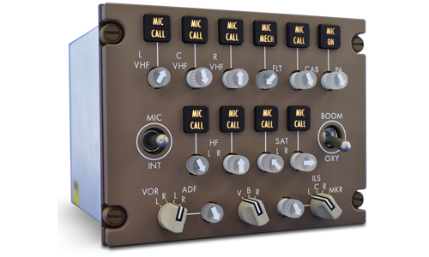
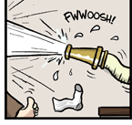
Pain Points in Core Workflows
Proprietary algorithms and software.
Good performance requires dataset-specific tweaking.
High data volumes.
Images: Dallas Card, Gables Engineering, PhD Comics

Slide 19
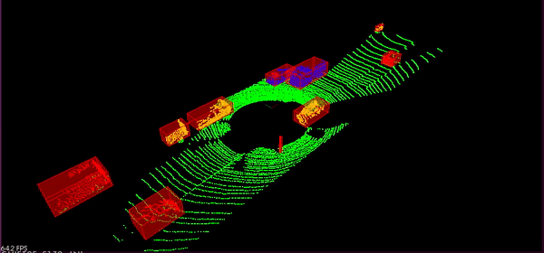
A view to the future
Fully automated pre-processing, clustering, segmentation, and feature extraction at scale.
Image: engineBozkurt

Slide 20
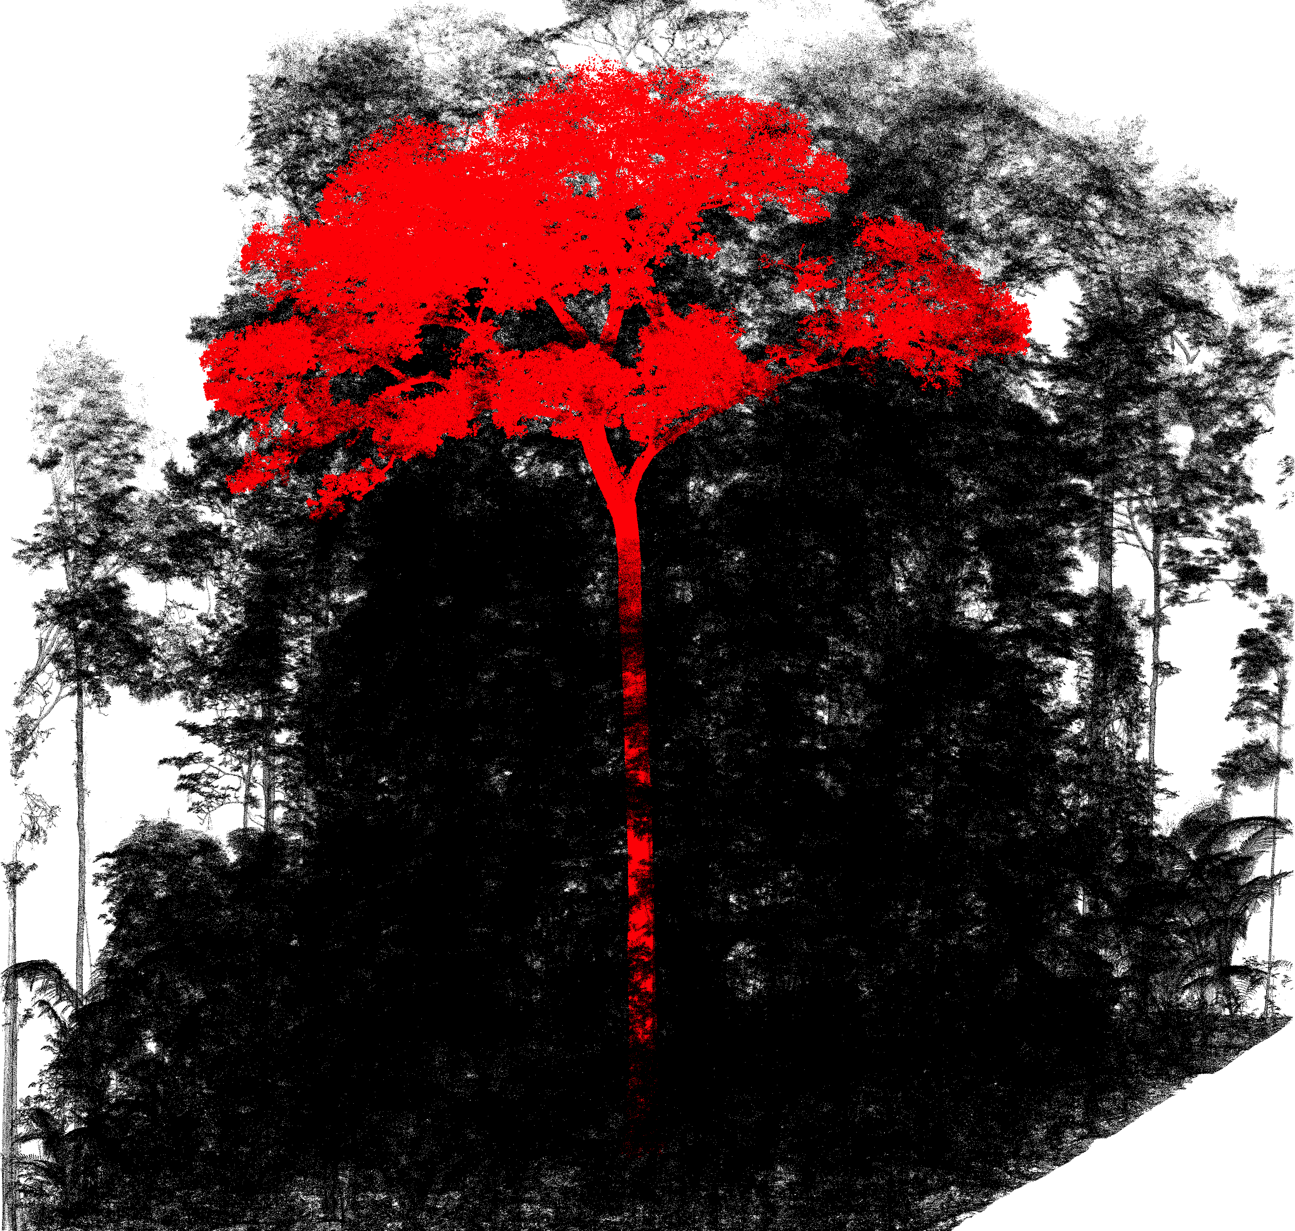
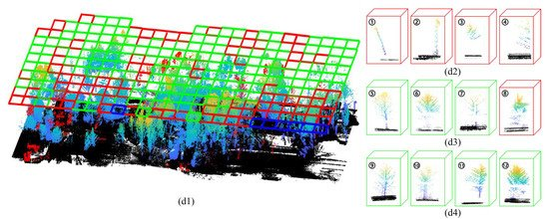
Projects to watch
TreeSeg – Burt et al. 2019
PointNet – Chen et al. 2020
Images: Burt et al. 2019, Chen et al. 2021

Slide 21
Outline
Why?
What?
How?
Why is this a good time to get comfortable with point cloud data?
What are the basic properties of point clouds, and how are they derived?
What are the strengths and weaknesses of SfM and LiDAR-derived point clouds
What are the core point cloud workflows?
Case Study: leveraging LiDAR point clouds to monitor forest mortality.
Demo: processing point clouds in CloudCompare and R

Slide 22
Case Study: mapping Quaking Aspen (Populus tremuloides) mortality dynamics using repeat LiDAR

Slide 23
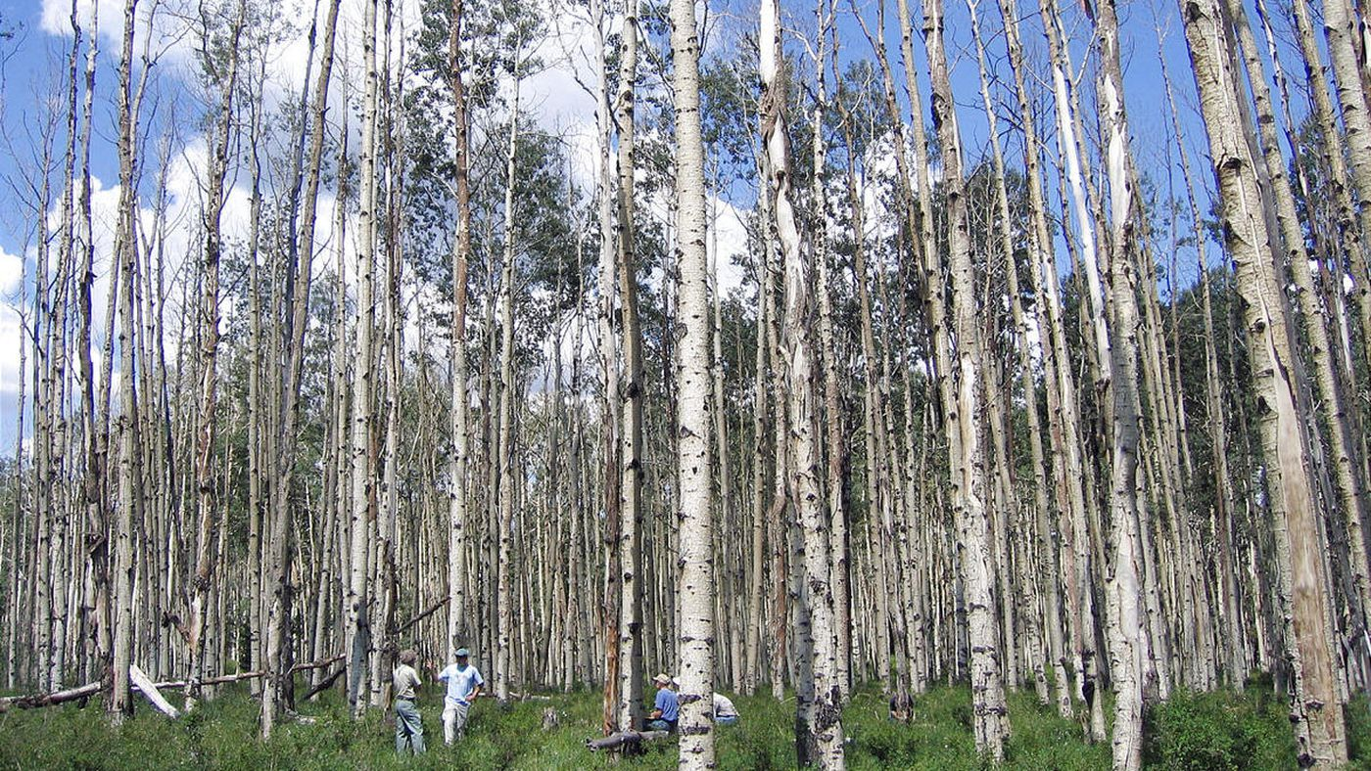
Photo: Deseret News

Slide 24

Demo: Processing point clouds using R and lidR
Free lidR Book by Roussel et al:
https://jean-romain.github.io/lidRbook/

Slide 25
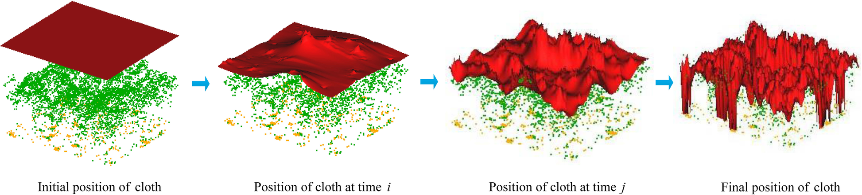
Cloth simulation filter
Figure: Zhang et al. 2020

Slide 26
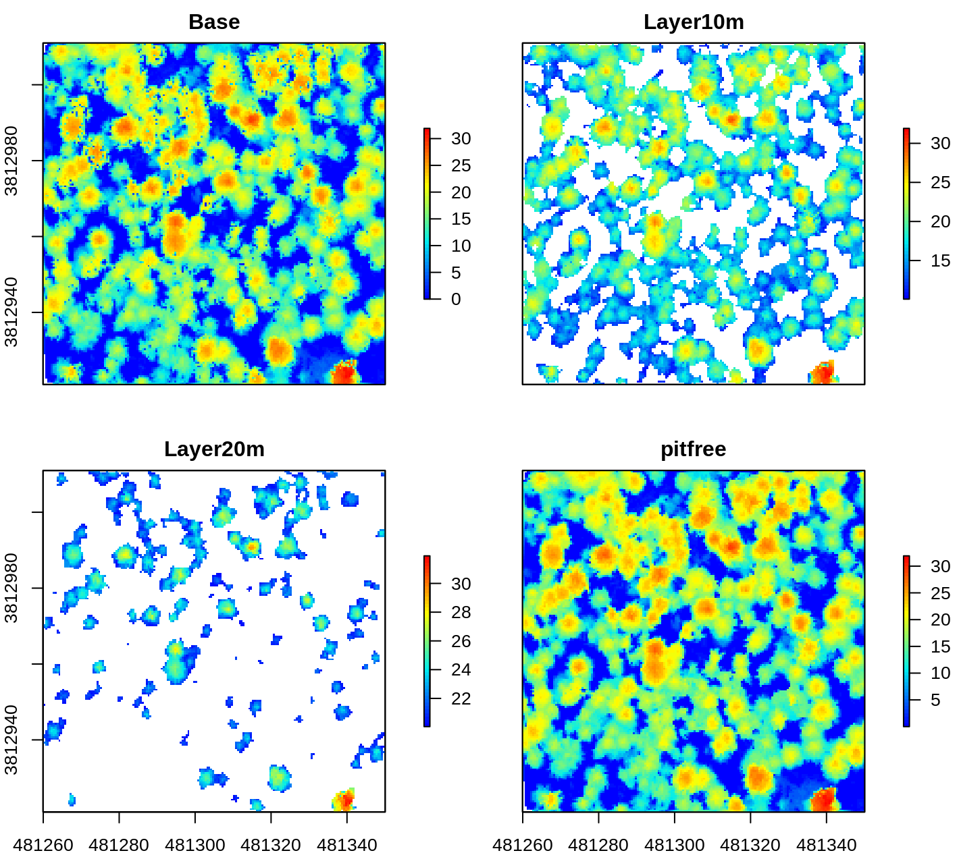
Dalponte Pitfree algorithm
Figure: Jean-Romain Roussel

Slide 27
Thanks!
Contact Me:
Ian Breckheimer
ikb@rmbl.org
Twitter, Github: @ibreckhe

Slide 28
References
Leblanc, S. G., & Fournier, R. A. (2014). Hemispherical photography simulations with an architectural model to assess retrieval of leaf area index. Agricultural and Forest Meteorology, 194, 64-76.
Zhang, Wuming, et al. "An easy-to-use airborne LiDAR data filtering method based on cloth simulation." Remote Sensing 8.6 (2016): 501.
Dalponte, M., & Coomes, D. A. (2016). Tree‐centric mapping of forest carbon density from airborne laser scanning and hyperspectral data. Methods in ecology and evolution, 7(10), 1236-1245.
Burt, A., Disney, M., & Calders, K. (2019). Extracting individual trees from lidar point clouds using treeseg. Methods in Ecology and Evolution, 10(3), 438-445.
Chen, X., Jiang, K., Zhu, Y., Wang, X., & Yun, T. (2021). Individual Tree Crown Segmentation Directly from UAV-Borne LiDAR Data Using the PointNet of Deep Learning. Forests, 12(2), 131.

